Slide 1
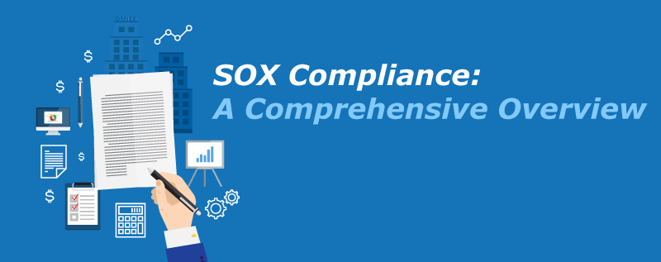
SOX Compliance Requirements
©BlackStratus

Slide 2
Preface
It has been more than 10 years since the initial passage of the Sarbanes-Oxley Act (SOX) of 2002 and, even today, many organizations still struggle to fulfill their auditing and compliance requirements. If not done smartly, meeting your obligations as a publicly traded company can be expensive, time-consuming and ultimately counterproductive for your business goals. It doesn’t have to be that way. The more you know ahead of planning for an audit, the more seamless and effective the process will be.

Slide 3
Introduction
Let’s review some of the basics about this federal act.
Full name: Sarbanes-Oxley Act of 2002, known in US Senate as the “Public Company Accounting Reform and Investor Protection Act” and in the House of Representatives as the “Corporate and Auditing Accountability and Responsibility Act.” Commonly referred to as Sarbanes’Oxley, Sarbox or SOX.
Signed into law: July 30, 2002.
Sponsors: Sen. Paul Sarbanes (D-MD) and Rep. Michael G. Oxley (R-OH-4)
SOX was designed with the goal of implementing accounting and disclosure requirements that:
Increase transparency in corporate governance and financial reporting
Formalize a system of internal checks and balances

Slide 4
Introduction
SOX is applicable to:
All publically held American companies
Any international companies that have registered equity or debt securities with the U.S. Securities and Exchange Commission (SEC)
Any accounting firm or other third party that provides financial services to either of the above.
Penalties for non-compliance: Formal penalties for non-compliance with SOX can include fines, removal from listings on public stock exchanges and invalidation of D&O insurance policies. Under the Act, CEOs and CFOs who willfully submit an incorrect certification to a SOX compliance audit can face fines of $5 million and up to 20 years in jail.
The stated goal of SOX is “to protect investors by improving the accuracy and reliability of corporate disclosures.” Given that an organization’s IT infrastructure is the backbone of how it communicates, it makes sense that compliance with SOX should require introducing broad information accountability measures.

Slide 5
SOX Compliance and Data Security
For IT managers and executives setting out high-level data security goals, compliance with SOX is an important ongoing concern. But SOX compliance is about more than just being able to pass an audit – when appropriate data governance procedures are properly implemented, they can have a number of tangible benefits for your business. In fact, in a 2015 survey of more than 450 executives, conducted by Protiviti, it was found that:
78% of organizations leverage SOX compliance initiatives to drive continuous improvement around financial reporting
52% of organizations reported “significant” or “moderate” improvements in internal control over their financial reporting since the implementation of SOX
Ultimately, the report concluded, “this is a good indicator that these companies are proceeding on the right path with regard to treating SOX work not as a compliance exercise, but as a long-term process to create greater value in the organization. This is one of the outcomes the framers of the SOX legislation intended.”

Slide 6
SOX Compliance and Data Security
With that in mind, how can SOX compliance benefit you? Aside from eliminating the threat of fines and other penalties, smart organizations are using SOX as a framework for:
Auditing existing IT infrastructure, identifying inefficiencies, redundancies and superfluous controls.
Streamlining reporting and auditing processes, increasing productivity and reducing costs.
Managing security risks more effectively and responding quicker in the event of a breach.

Slide 7
Beginning Steps to Compliance
The first thing an IT manager must do to prepare their organization for SOX compliance is to understand which sections of the act have clear implications for data management, reporting and security. These are:
Section 302: SOX Section 302 relates to a company’s financial reporting. The act requires a company’s CEO and CFO to personally certify that all records are complete and accurate. Specifically, they must confirm that they accept personal responsibility for all internal controls and have reviewed these controls in the past 90 days. These internal controls include a company’s information security infrastructure inasmuch as its accounting and reporting is performed electronically in other words, for almost all modern businesses there is a clear mandate to ensure high security standards are enforced.
Section 404: Section 404 stipulates further requirements for the monitoring and maintenance of internal controls related to the company’s accounting and financials. It requires businesses to have an annual audit of these controls performed by an outside firm. This audit assesses the effectiveness of all internal controls and reports its findings back directly to the SEC.

Slide 8
Beginning Steps to Compliance
A SOX compliance audit is a measure of how well your company manages its internal controls. While SOX doesn’t specifically mention information security, for practical purposes, an internal control is understood to be any type of protocol dealing with the infrastructure that handles your financial data.
Indeed, one of the biggest criticisms of SOX is that, particularly for smaller firms, this requirement that all accounting systems must be subject to auditing is prohibitively expensive.

Slide 9
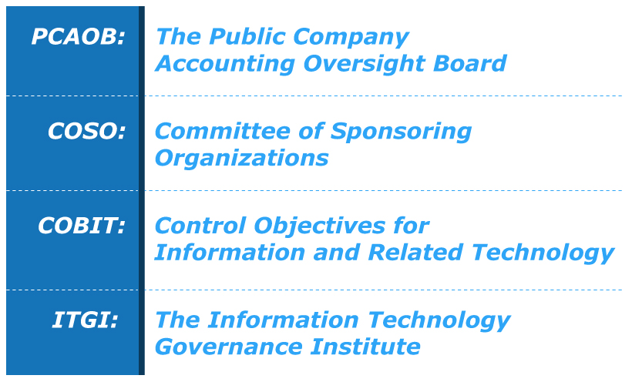
Other Things to Know Before You Begin
The Sarbanes-Oxley Act is over 60 pages long. Beyond that, it has spawned a number of related concepts, committees and policies related to the auditing process. Some acronyms you need to know before beginning to assess your organization’s SOX compliance requirements include:

Slide 10
Other Things to Know Before You Begin
PCAOB: The Public Company Accounting Oversight Board was created to develop auditing standards and train auditors on the best practices for assessing a company’s internal controls. It is here that the specific SOX requirements for information security are spelled out. PCAOB publishes periodic recommendations and changes to the auditing process. For obvious reasons, being aware of the most recent iteration of these guidelines is essential to passing an audit.
COSO: COSO is the Committee of Sponsoring Organizations, a joint organization consisting of representatives from the Institute of Management Accountants (IMA), the American Accounting Association (AAA), the American Institute of Certified Public Accountants (AICPA), the Institute of Internal Auditors (IIA) and Financial Executives International (FEI). Since 1992, COSO has published periodic updates to their internal control framework recommendations this document outlines guidelines for creating and implementing internal controls, and serves as the basis for the auditing standards developing by PCAOB.

Slide 11
Other Things to Know Before You Begin
COBIT: COBIT (Control Objectives for Information and Related Technology) is a framework published by ISACA. Formally known as the Information Systems Audit and Control Association, ISACA covers guidelines for developing and assessing internal controls related to corporate information technology. Effectively a more specific version of the COSO framework, it outlines best practices for 34 IT processes. Many organizations will rely on both frameworks when developing a roadmap to SOX compliance.
ITGI: The Information Technology Governance Institute (ITGI) is dedicated to helping businesses meet their objectives without compromising information security. ITGI has independently published its own framework for SOX compliance, using both COBIT and COSO as guides. Unlike COBIT, however, the ITGI framework deals only with security issues.

Slide 12
SOX Compliance Checklist
Every organization and every audit is different, which is why the idea of a universal SOX compliance checklist isn’t a particularly useful one. There are, however, a few general questions every business should consider. Before an audit, ask yourself:
Am I working from an accepted framework, whether it’s COSO, COBIT, ITGI or a combination of all 3?
Have policies been established that outline how to create, modify and maintain accounting systems, including computer programs handling financial data?
Are safeguards in place to prevent data tampering? Have they been tested and found operational?
Is there protocol for dealing with security breaches?
Is access to sensitive data being monitored and recorded?
Have previous breaches and failures of security safeguards been disclosed to auditors?
Have I collected valid, recent SAS 70 reports from all applicable service organizations?

Slide 13
PCAOB Requirement for IT Controls
PCAOB Auditing Standard No. 2 discusses the relationship of IT and internal control over financial reporting and emphasizes the importance of identifying IT controls and testing their design and operational effectiveness.
In particular, it states:
…Controls should be tested, including controls over relevant
assertions related to all significant accounts and disclosures in
the financial statements. Generally, such controls include
[among others]:
• Controls, including information technology general controls,
on which other controls are dependent.
Courtesy: IT_Control_Obj_for_SOX_2nd Edition

Slide 14
PCAOB Requirement for IT Controls
Where to Find IT Controls
In understanding where IT controls exist within the typical company, consideration of at least three elements should be given: executive management, business process and IT services.
Executive management establishes and incorporates strategy into business activities.
Business processes are the organization’s mechanism of creating and delivering value to its stakeholders.
IT services form the foundation for operations and are provided across the organization, rather than segregated by business process or business unit.

Slide 15
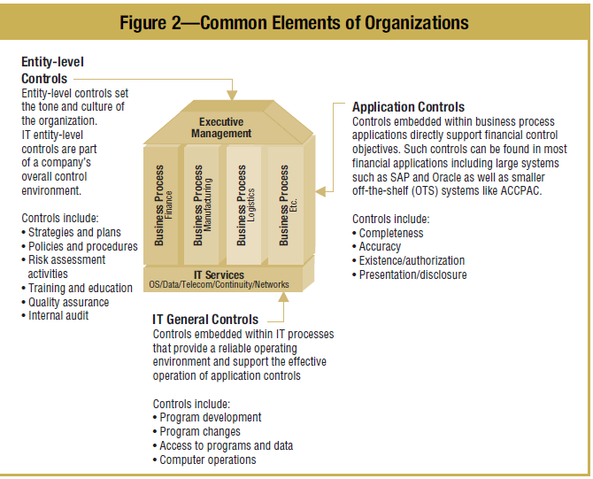
PCAOB Cont..

Slide 16
Information Technology Controls—A Unique Challenge
The Sarbanes-Oxley Act makes corporate executives explicitly responsible for establishing, evaluating and monitoring the effectiveness of internal control over financial reporting. For most organizations, the role of IT will be crucial to achieving this objective.
Whether through a unified ERP system or a disparate collection of operational and financial management software applications, IT is the foundation of an effective system of internal control over financial reporting.

Slide 17
Information Technology Controls—A Unique Challenge
Organizations need representation from IT on their Sarbanes-Oxley teams to determine whether IT monitoring controls, general controls and application controls exist and support the objectives of the compliance effort. Some of the key areas of responsibility for IT include:
• Understanding the organization’s internal control program and its financial reporting process
• Mapping the IT systems that support internal control and the financial reporting process to the financial statements
• Identifying risks related to these IT systems
• Designing and implementing controls designed to mitigate the identified risks and monitoring them for continued effectiveness
• Documenting and testing IT controls
• Ensuring that IT controls are updated and changed as necessary to correspond with changes in internal control or financial reporting processes
• Monitoring IT controls for effective operation over time
• Participation by IT in the Sarbanes-Oxley project management office

Slide 18
Controls Over IT Systems
With widespread reliance on IT systems, controls are needed over such systems, large and small. IT controls commonly include controls over the IT environment, computer operations, access to programs and data, program development, and program changes. These controls apply to systems that have been determined to be financially significant.
IT Control Environment
The control environment has become more important in PCAOB Auditing Standard No. 2.

Slide 19
IT Control Environment
Computer Operations
Access to Programs and Data
Program Development and Program Change

Slide 20
Compliance and IT Governance
There is no such thing as a risk-free environment, and compliance with the Sarbanes-Oxley Act does not create such an environment. However, the process that most organizations will follow to enhance their system of internal control to conform to the Sarbanes-Oxley Act is likely to provide lasting benefits. Good IT governance over planning and life cycle control objectives should result in more accurate and timely financial reporting.
Building a strong internal control program within IT can help to:
Enhance overall IT governance
Enhance the understanding of IT among executives

Slide 21
Compliance and IT Governance
Enable better business decisions by providing higher-quality, more timely information
Align project initiatives with business requirements
Prevent loss of intellectual assets and the possibility of system breach
Contribute to the compliance of other regulatory requirements, such as privacy
Gain competitive advantage through more efficient and effective operations
Optimize operations with an integrated approach to security, availability and processing integrity
Enhance risk management competencies and prioritization of initiatives

Slide 22
Managing the Human Element of Change
Committing to Change
Assess the Current State
Overcome the Obstacles

Slide 23
Applying COSO to Information Technology
For Sarbanes-Oxley compliance efforts, it is important to demonstrate how IT controls support the COSO framework. An organization should have IT control competency in all five of the components COSO identifies as essential for effective internal control. They are:
Control environment
Risk assessment
Control activities
Information and communication
Monitoring

Slide 24
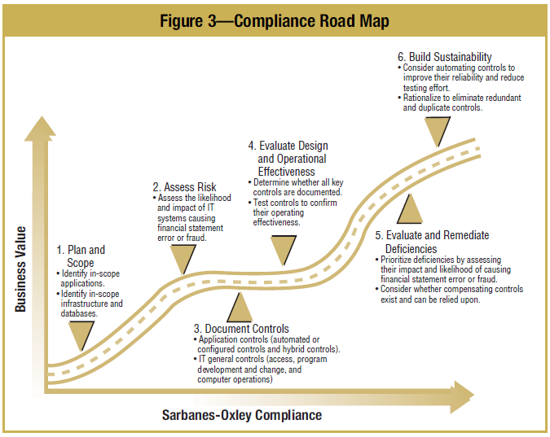
Road Map for Compliance

Slide 25
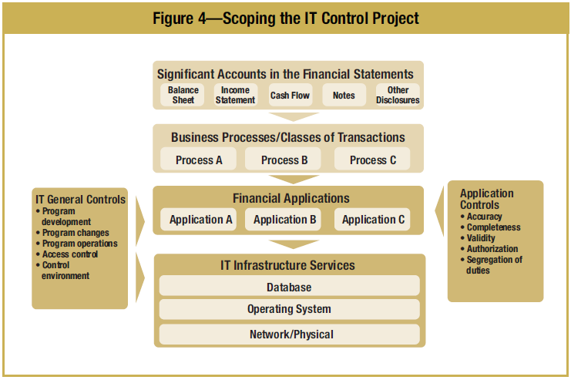

Slide 26
The End

